Slide 1
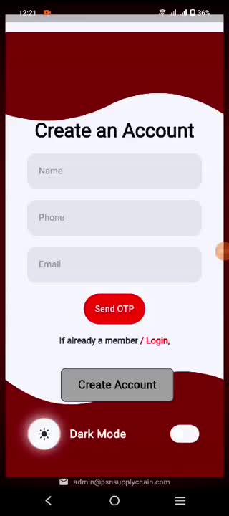


PSN Headon
The PSN HeadOn app, developed by Technowin IT Infra Pvt. Ltd., is a mobile application built using Flutter. 🚀 It offers seamless and intuitive features designed to enhance user experience. 💡 The app integrates advanced functionalities to provide efficient solutions for users, ensuring smooth performance across multiple platforms. 📱⚡

Slide 2
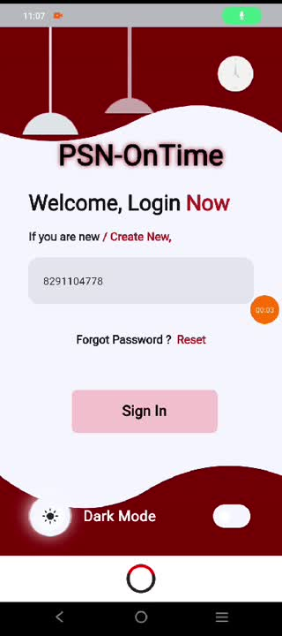
PSN OnTime
The PSN Ontime app, created by Technowin IT Infra Pvt. Ltd., is a mobile application developed with Flutter. 🚀 It delivers smooth and user-friendly features aimed at improving the user experience. 💡 The app incorporates advanced capabilities to offer effective solutions, ensuring optimal performance across various platforms. 📱⚡

Slide 3
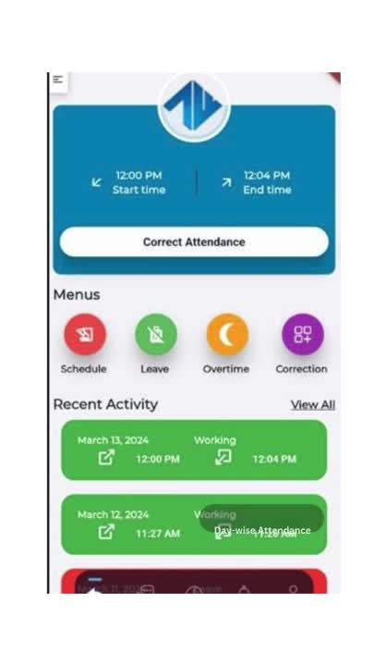
Human Resource
Management System App
The Human Resource Management System (HRMS) App, developed by Technowin IT Infra Pvt. Ltd., is a comprehensive solution for managing HR tasks efficiently. 💼📱 It offers user-friendly features to streamline employee data management, payroll processing, leave tracking, and more. ⚙️💡 The app ensures smooth performance across platforms, helping businesses optimize their HR operations seamlessly. ⚡👩‍💼👨‍💼

Slide 4
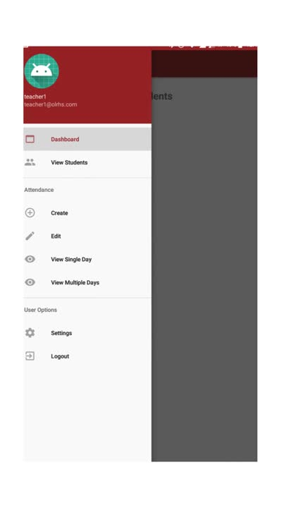

Attendance capture
Mobile App
The Attendance Capture Mobile App, developed by Technowin IT Infra Pvt. Ltd. for Old Lady Remedy High School, is a seamless solution for managing student attendance. 📚💡 The app is designed for ease of use, offering quick and efficient attendance tracking with an intuitive interface. 📱✅ It ensures smooth performance across devices, making attendance management hassle-free for both staff and students. ⚡🎓

